Slide 1


Work Assignment
Arquiteturas Avançadas
Grupo 2
António Sérgio Alves Costa - A78296
José Pedro Moreira Resende - A77486

Slide 2
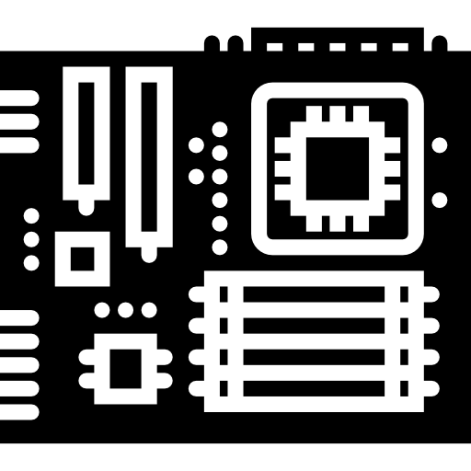

Hardware Characterization

Slide 3
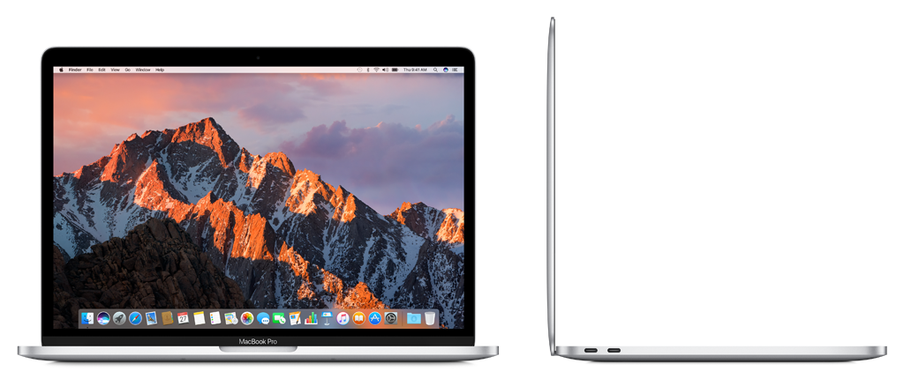
Laptop
Apple MPXU2PO/A
CPU:
Intel(R) Core(TM) i5-7360U
CLOCK FREQUENCY: 2.30GHz
BANDWITH: 19.728 GB/s

Slide 4
Laptop
32KB
(per core)
L1(D/I)
256KB
(per core)
L2
Memory Hierarchy
4MB
(shared)
L3
8GB
RAM

Slide 5
Laptop
Peak GFlops = Number of processors x Number of cores x Clock frequency x SIMD width x FMA
2 x 2 x 2.3 x 8 x 2
147,2 GFlops
Theoretical Peak Performance

Slide 6
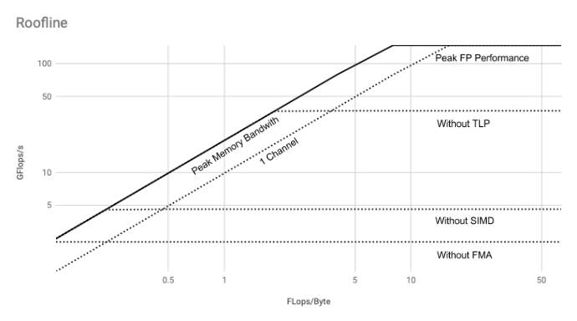
Roofline Model Laptop

Slide 7
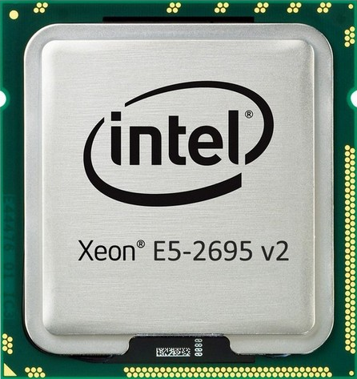
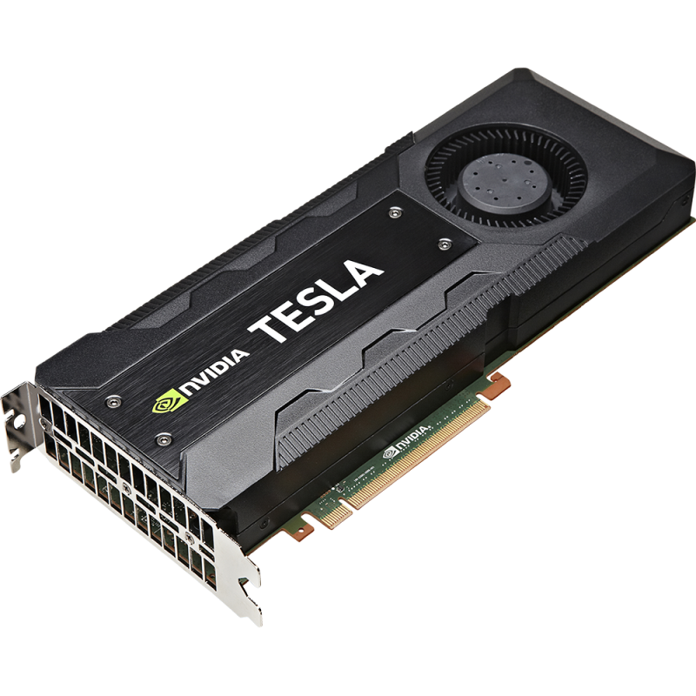
Cluster 662-node
CPU:
Intel® Xeon® Processor E5-2695 v2
CLOCK FREQUENCY: 2.40GHz
BANDWITH: 46,19GB/s
GPU:
NVIDIA® TESLA® K20
CUDA PARALLEL PROCESSING CORES: 2496
PROCESSOR CORE CLOCK: 706MHz

Slide 8
Cluster 662-node
32KB
(per core)
L1(D/I)
256KB
(per core)
L2
Memory Hierarchy
30MB
(shared)
L3
64GB
RAM

Slide 9
Cluster 662-node
Peak GFlops = Number of processors x Number of cores x Clock frequency x SIMD width x FMA
2 x 12 x 2.4 x 8 x 1
460,8 GFlops
Theoretical Peak Performance

Slide 10
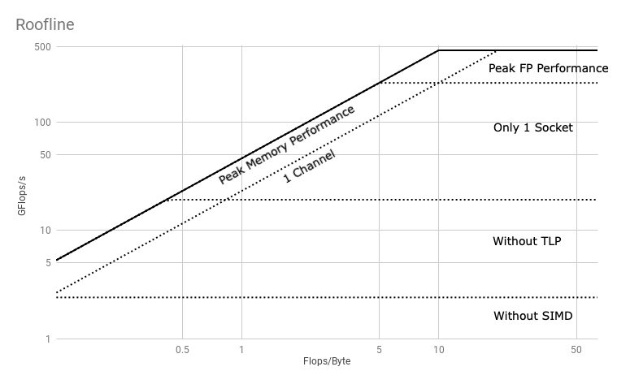
Roofline Model Cluster 662-node

Slide 11
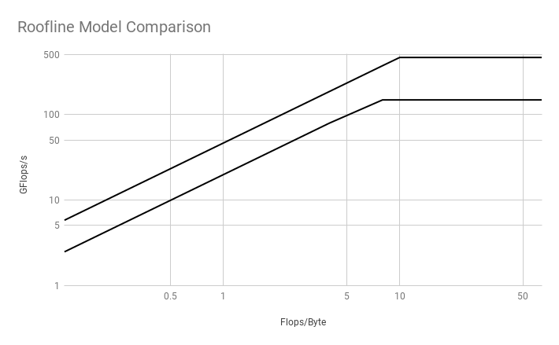
Roofline Model Comparison

Slide 12
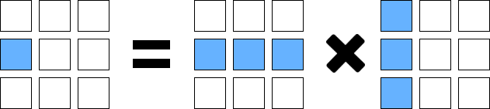
Case Study
Matrix-matrix Multiplication Optimization

Slide 13

Which data set should we use ?
1 FOR EACH MEMORY LEVEL
L1:
L2:
L3:
32KB
32/4 = 8000 Floats
8000/3 = 2666 Floats per matrix
51 * 51 (max matrix size)
256KB
256/4 = 32000 Floats
64000/3 = 21333 Floats per matrix
146 * 146 (max matrix size)
30MB
30/4 = 7.5M Floats
8000/3 = 2.5M Floats per matrix
1581 * 1581 (max matrix size)

Slide 14
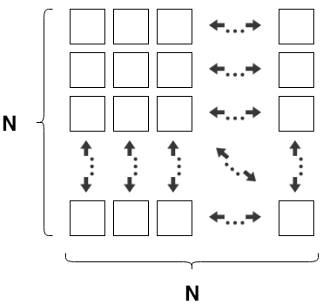
Data Sets
L1:
L2:
L3:
RAM:
32KB
N=32
256KB
N=128
30MB
N=1024
64GB
N=2048
Which N ?

Slide 15

PAPI Usage
Chosen metrics
Time: gettimeofday (microsec precision)
L1 miss-rate: PAPI_L2_DCR / PAPI_LD_INS
L2 miss-rate: PAPI_L3_DCR / PAPI_L2_DCR
L3 miss-rate: PAPI_L3_TCM / PAPI_L3_TCA
RAM accesses: PAPI_L3_TCM
Flops: PAPI_FP_INS

Slide 16
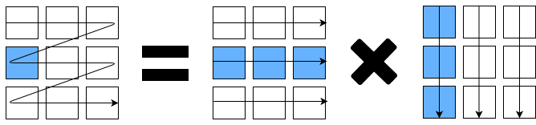
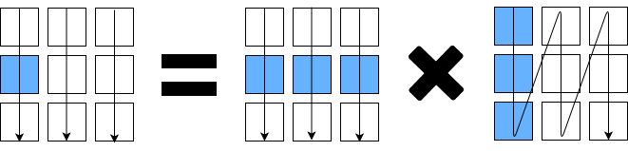
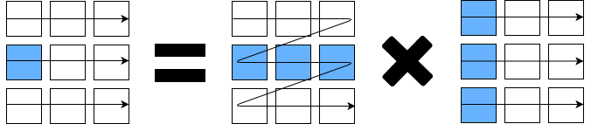
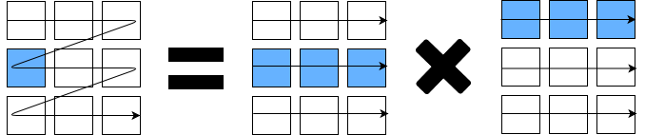
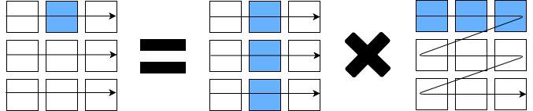
ALGORITHMS
IJK
JKI
IKJ
IJK-Trans
JKI-Trans

Slide 17
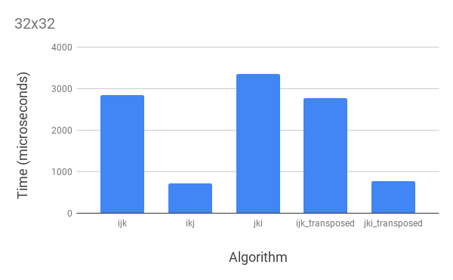
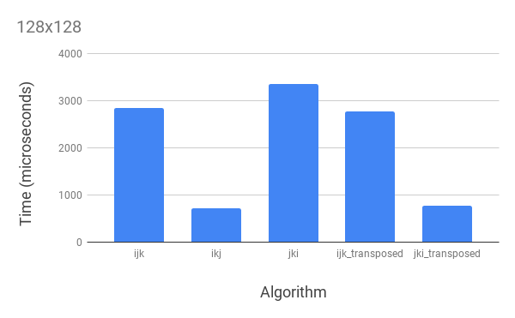
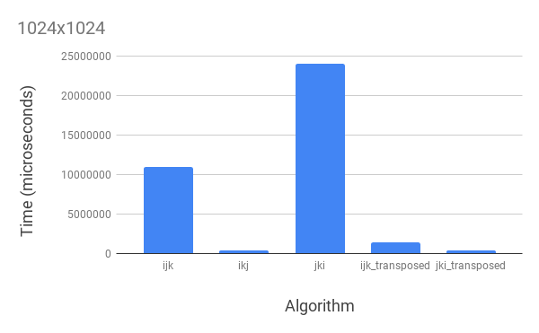
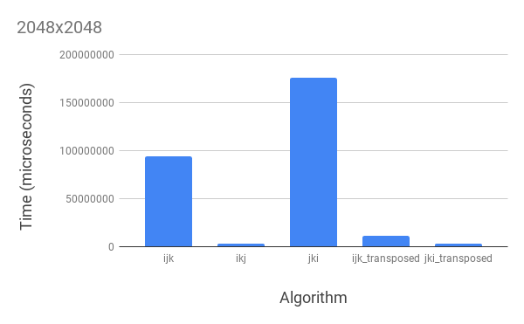
Results (TIME)
32x32
128x128
1024x1024
2048x2048

Slide 18
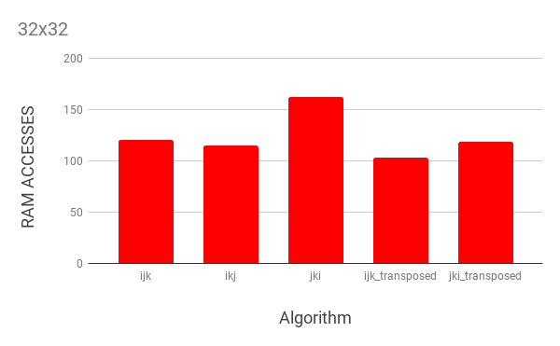
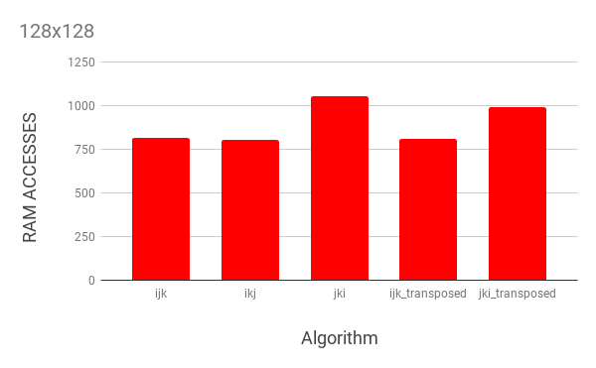
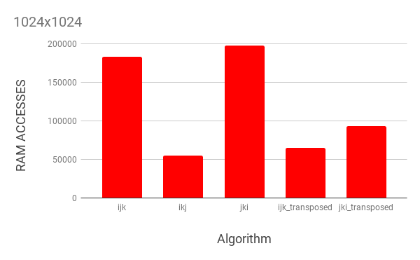
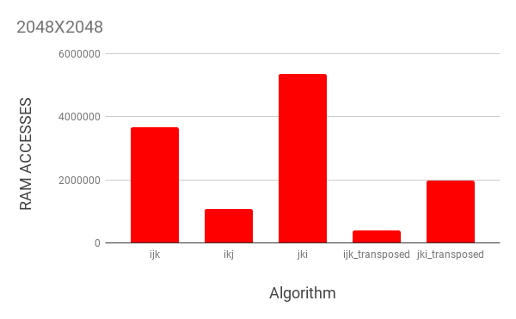
Results (RAM Accesses)
32x32
128x128
1024x1024
2048x2048

Slide 19
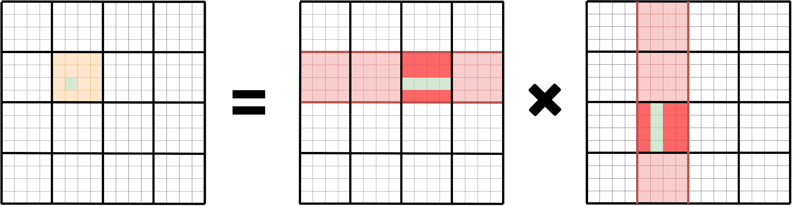
BLOCKING ALGORITHMS
BLOCK
BLOCK w/ OMP
BLOCK w/ OMP & VEC
Number of threads: 24
Block size: 32
BLOCK w/ VEC

Slide 20
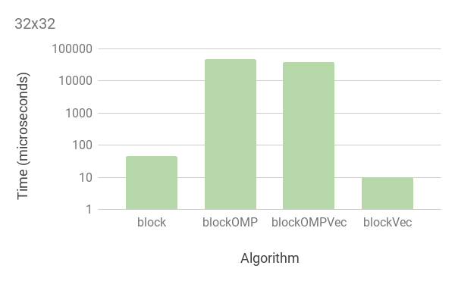
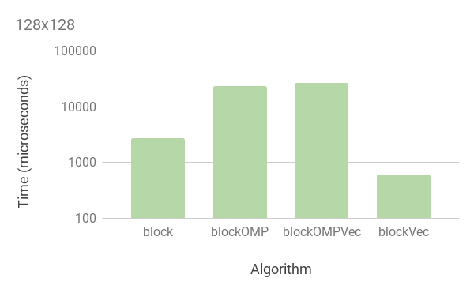
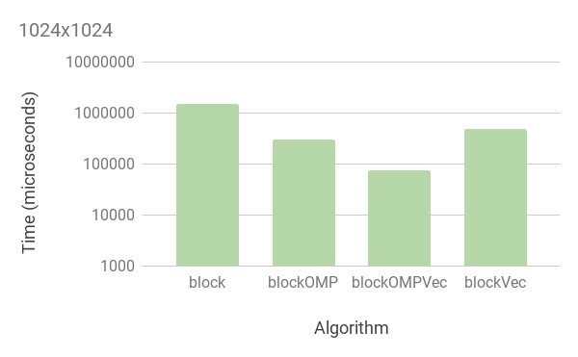
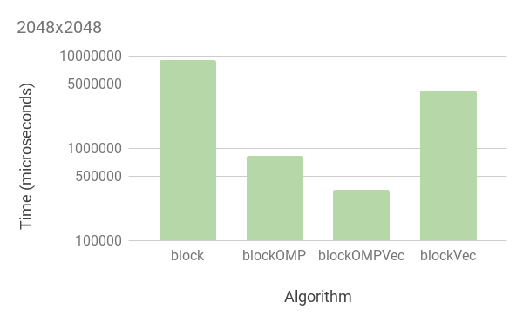
Results (TIME)
32x32
128x128
1024x1024
2048x2048

Slide 21
KNL ALGORITHM
Threads:
32
64
128
256

Slide 22
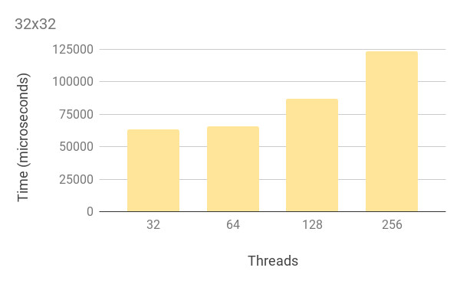
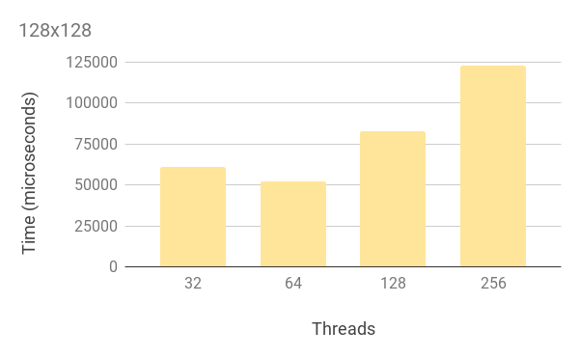
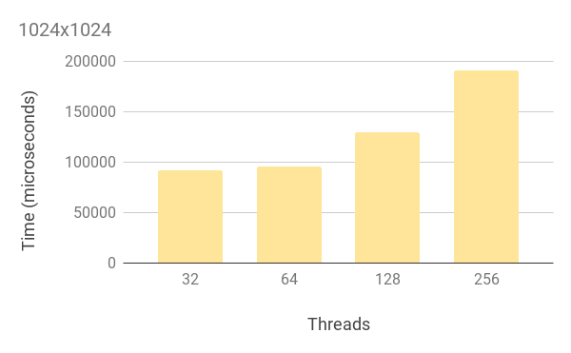
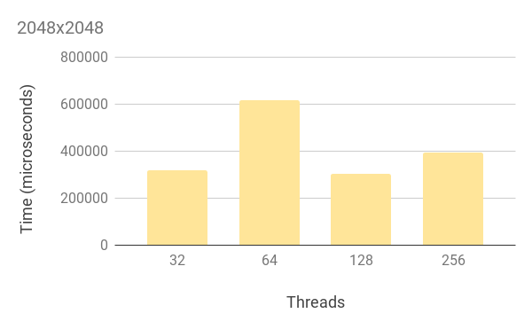
Results (TIME)
32x32
128x128
1024x1024
2048x2048

Slide 23
CUDA Algorithm
SHARED MEMORY
SIMPLE

Slide 24
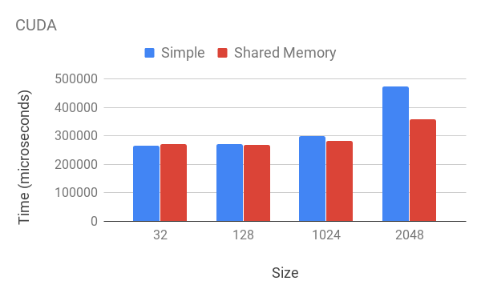
Results (TIME)

Slide 25
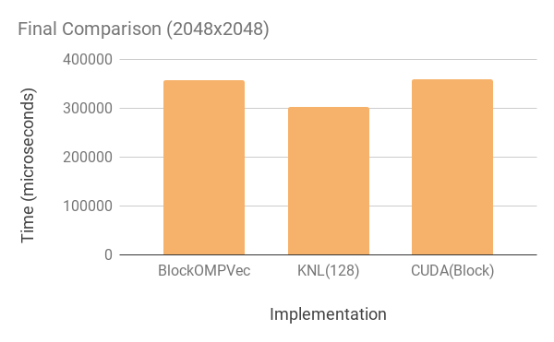
Final Comparison

Slide 26
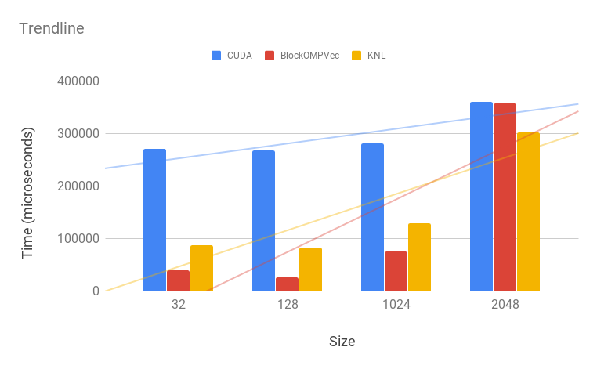
Trendline

Slide 27
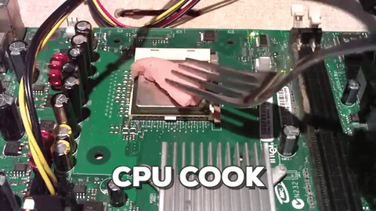
Work Assignment
Arquiteturas Avançadas
Grupo 2
António Sérgio Alves Costa - A78296
José Pedro Moreira Resende - A77486

